Slide 1
MID ROAD HELPER
Under the guidance of
Dr. E. UMA Assistant Professor (SL.GR) Department of Information Science and Technology(DIST)
BALASANKAR S
2019202005
MCA(REGULAR)

Slide 2
Project Introduction
Mid Road Helper is a web application.
This application is going to be good solution for the people who need help in the mid road with the issue in vehicle.
Mid road helper helps user to connect with the helper services.
Helper services are the company who solve the problems (Mechanical issues, towing and fuel required).
Helper services are approved by the admin.
Only approved helper services details are listed to users.

Slide 3
Modules
User Module:
User needs to register and login.
Problems are listed, user need to select the problem.
Helper service within 5-10 km radius are listed to the user.
Send request to the Helper service.
Connect with the helper service and send current location using chat.
Pay for a service.
Give feedback about service.
Get service bill details in email

Slide 4
Modules Continue…
Helper Service Module
Helper services register and login
Wait for admin approval
Accept user request and get user current location via chat
After service send payment bill to the user via email.
Admin Module
Approve Helper service
Manage user/Helper service
Manage bill and feedback of helper services

Slide 5
Technologies used
This application is going to develop using HTML, CSS as frontend.
For backend PHP and MYSQL is used.
Visual Studio code is used for coding HTML,CSS,PHP.
XAMPP server is used for database purposes.
The most common attacks, SQL Injection and Cross Site Scripting (XSS) are prevented in this application
Google Map API are used for location purposes.
Simple Mail Transfer Protocol (SMTP) is used for sending mail.

Slide 6
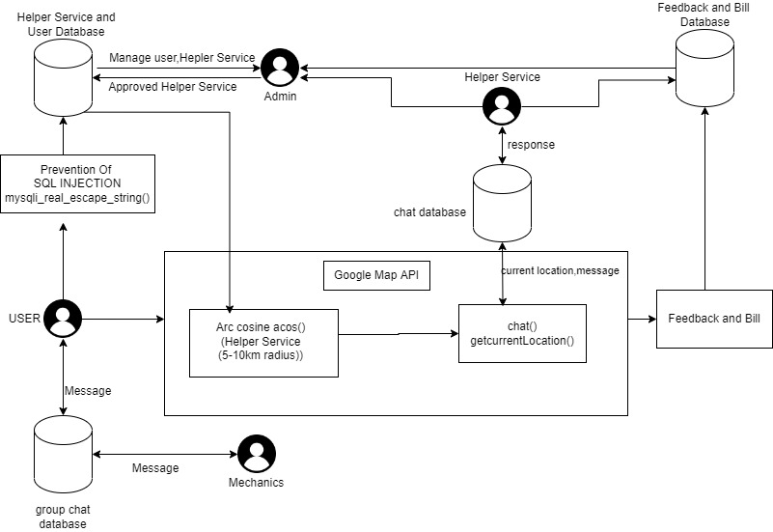
ARCHITECTURE DIAGRAM

Slide 7
THANK YOU….

